Slide 1
Text Mining Project
Zubair Rafiq
Ahmad Bilal Sohail Eltun Ibrahimov

Slide 2
Rhetorical Figure Detection in Political Texts
Major themes:
Natural language processing
Text mining
Information extraction
Text classification
Machine learning

Slide 3
Platforms and Libraries
Python 3/ Jupyter Notebook
Natural language processing toolkit (NLTK) → nltk
Scikit-learn toolkit
Pandas → pandas as pd

Slide 4
Corpora
United States Presidential Speeches
Constituting political speeches of 44 presidents
Approximately 4.2 million words
Link → https://www.kaggle.com/littleotter/united-states-presidential-speeches

Slide 5
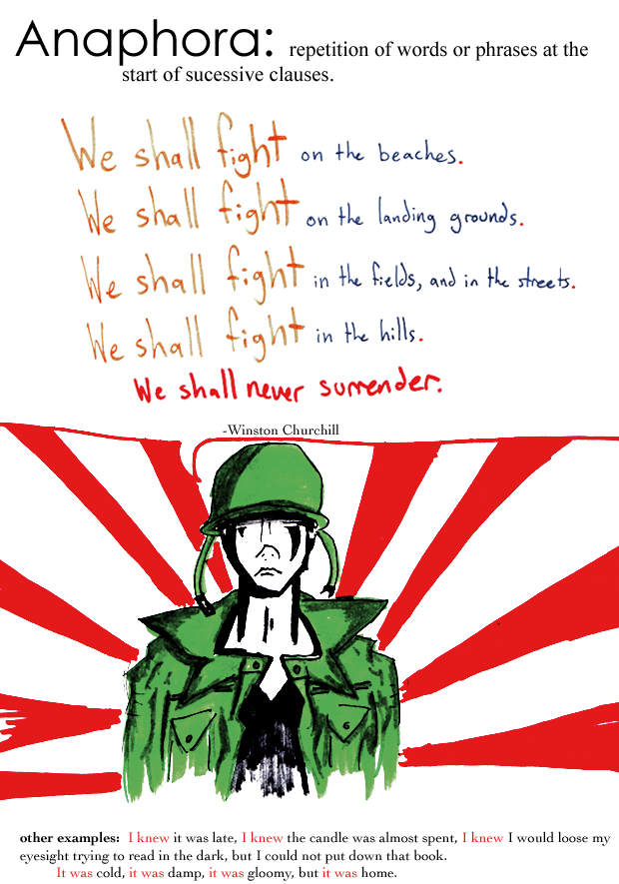
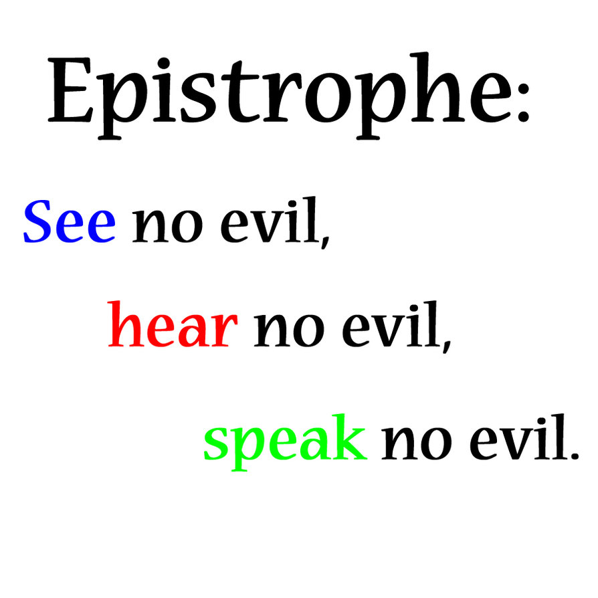
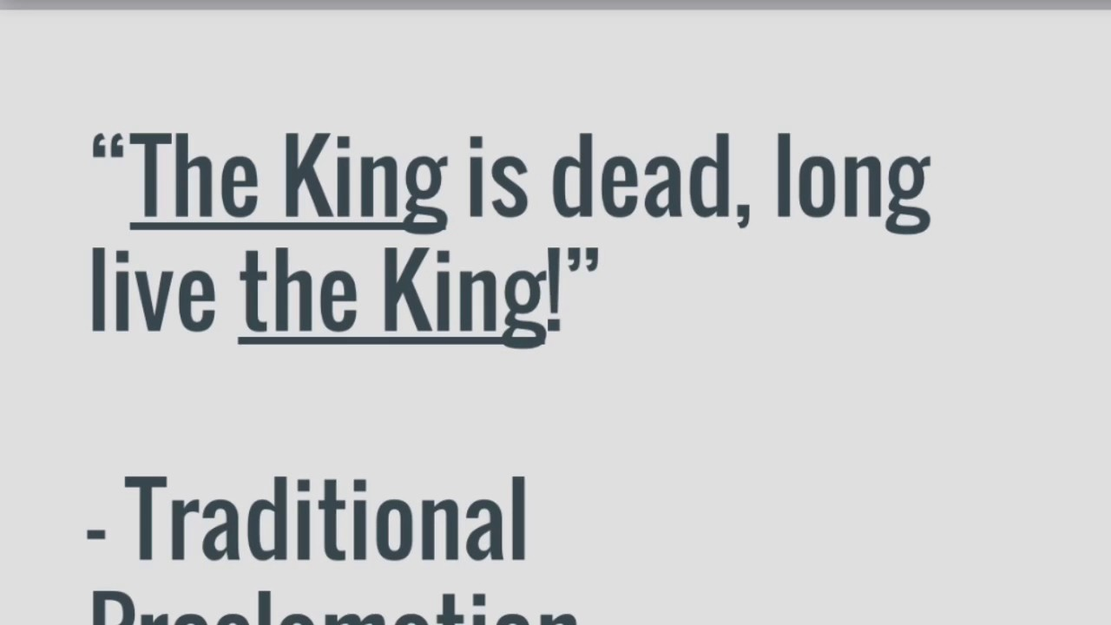
Rhetorical Figures
Epanaphora/Anaphora
Epistrophe/Epiphora
Epanalepsis

Slide 6
Flow
Corpora upload
Cleaning of text
Corner phrases extraction
Applying algorithms
Data Frame construction
Machine learning
Evaluation

Slide 7
Text Cleaning
Lowering of characters
Removal of numbers
Removal of punctuations

Slide 8
Extracting corner phrases from the sentences
For Anaphora
def get_sentence_start(sentence, n):
For Epiphora
def get_sentence_end(sentence, n):
For Epanalepsis
def get_sentence_start(sentence, n):
def get_sentence_end(sentence, n):

Slide 9
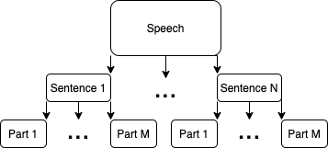
Splitting the Text
sent_tokenize
word_tokenize

Slide 10
Features for Anaphora Algorithm
Average Sentence length:
The smaller the length of sentence containing repetition, more the chances for it being actual anaphora since short sentences maintains the emotional effect
Number of successive sentences:
N values chosen to 3 to avoid any accidental repetition getting counted as figure of speech.
Strong punctuation:
Presence of punctuation increase the chance of sentences being an anaphora provided they have repetitions

Slide 11
Features for Epiphora Algorithm
Sentence length difference:
Sentences with epiphora should have same number of tokens to maintain rhythmic/balanced sounds
Number of successive sentences:
N values chosen to 3 to avoid any accidental repetition getting counted as figure of speech.
Avoid identical sentences:
e.g., “don't do it.don't do it.don't do it."

Slide 12
Construction of Data Frames for Anaphora
Adding features obtained from previous classification
Text
No of Successive Sentences
Average Sentence Length
Does it contain Punctuation
Manually checking the detected sentences from the algorithms and marking all whether a sentence is actually an anaphora or not.
Adding binary classification

Slide 13
Construction of Data Frames for Epiphora
Adding features obtained from previous classification
Text
Sentence Length Difference
Number of Successive Sentences
IsIdentical
Manually checking the detected sentences from the algorithms and marking all whether a sentence is actually an epiphora or not.
Adding binary classification

Slide 14
Logistic regression vs Decision tree
Decision boundary
Interpretability
https://blog.bigml.com/2016/09/28/logistic-regression-versus-decision-trees/

Slide 15
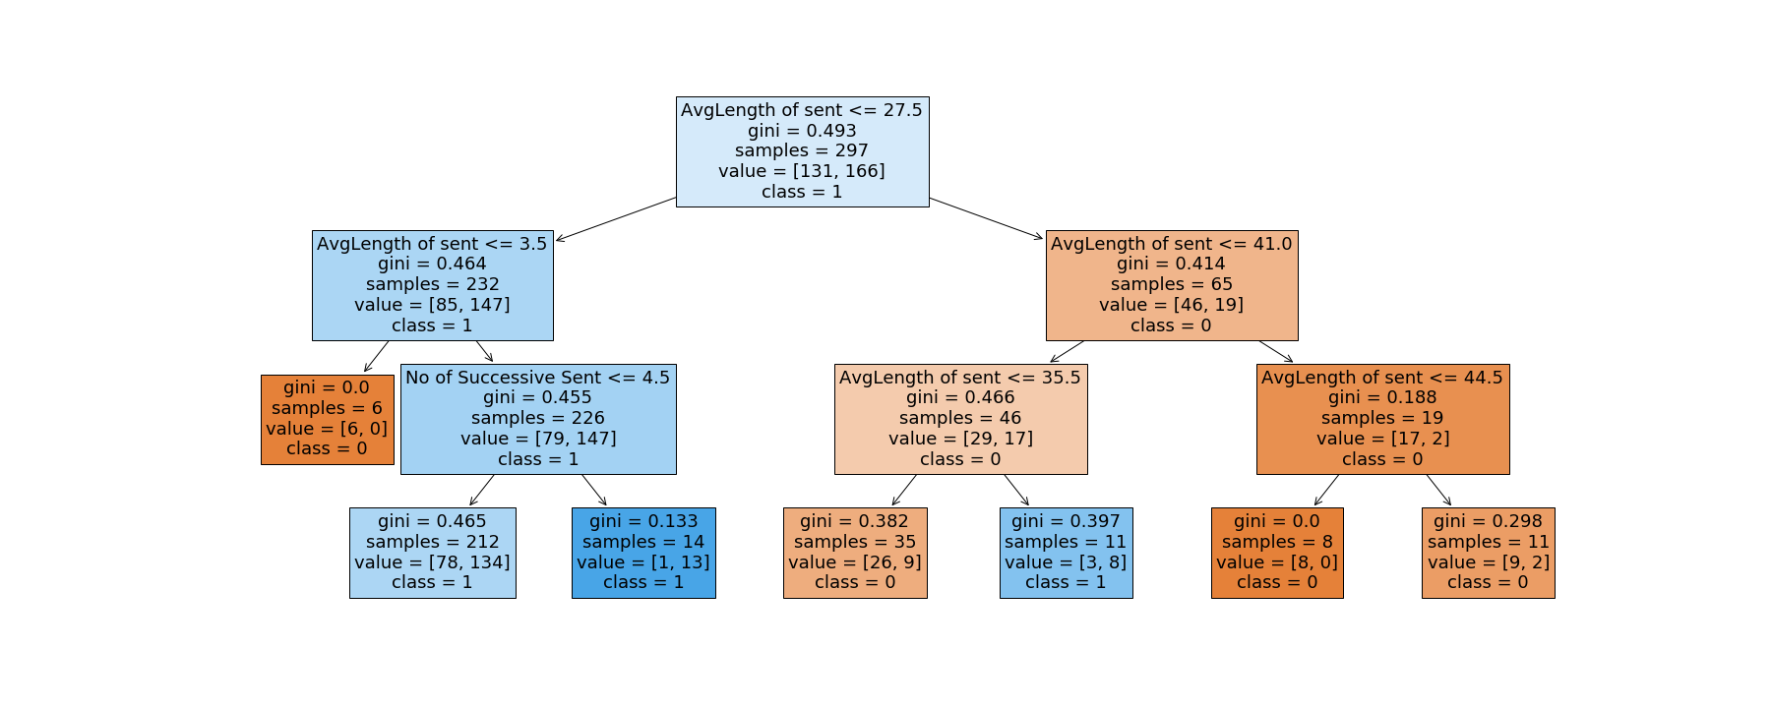
Anaphora

Slide 16
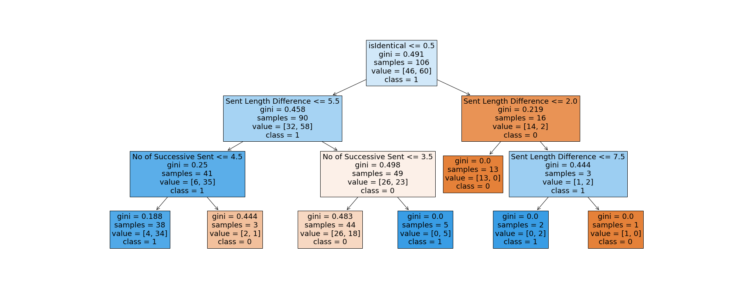
Epiphora

Slide 17
Empirical Results
 | Anaphora | Epiphora | Epanalepsis
Occurrences | 372 | 133 | 57
Accuracy | 0.71 | 0.74 | --
F1-Score | 0.79 | 0.8 | --

Slide 18
Challenges faced and Future Work
Comparing the results from this study to know which president was a better orator.
Choosing other features might result in more better results.
Choosing features for Epanalepsis was not efficiently done.
Choosing some other classifier approach might result in better results.

Slide 19
References
[1] J. Gawryjolek, C. DiMarco and R. Harris, An Annotation Tool for Automatically Detecting Rhetorical Figures SYSTEM DEMONSTRATION, 2009.
[2] M. Dubremetz and J. Nivre, Rhetorical Figure Detection: Chiasmus, Epanaphora, Epiphora, 2018, p. 10.
[3] M. Dubremetz and J. Nivre, Rhetorical Figure Detection: the Case of Chiasmus, Denver, Colorado, USA, 2015, pp. 23–31.
[4] M. Dubremetz and J. Nivre, Machine Learning for Rhetorical Figure Detection: More Chiasmus with Less Annotation, Gothenburg, Sweden, 2017, pp. 37–45.
[5] J. J. Gawryjolek, Automated Annotation and Visualization of Rhetorical Figures, 2009, http://hdl.handle.net/10012/4426.
[6] S. Ruan, C. D. Marco and R. A. Harris, Rhetorical Figure Annotation with XML, 2016.
[7] B. Englard, A Rhetorical Analysis Approach to Natural Language Processing, 2013.

Slide 20
Thank you for your Attention

